Slide 1
Welcome Please turn off your microphone and video Questions can be asked in the chat
Velkommen
Denne træningssession bliver optaget
Sluk venligst for mikrofon og video
Spørgsmål kan stilles via chatten

Slide 2
Welcome Please turn off your microphone and video Questions can be asked in the chat
Introduktion til Foundgood
Webinar - December 2023
Head of Data, NNF-Impact
​Rasmus Lund Jensen
Junior Analyst, NNF-Impact
​Kristian Raudal

Slide 3
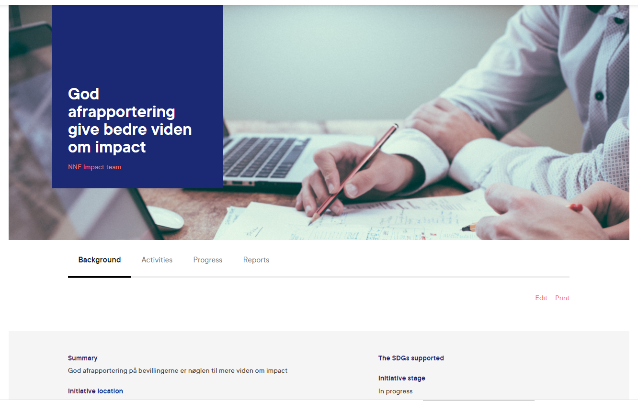
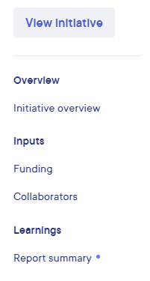
Agenda
Introduktion til Foundgood platformen
Novo Nordisk Fondens erfaringer med Foundgood
Step by Step gennemgang af rapportering til Novo Nordisk Fonden
Stil spørgsmål til din rapportering

Slide 4
Foundgood
Novo Nordisk fonden anvender Foundgood som afrapporteringssystem for bevillinger på det sociale og humanitære område samt på uddannelses-, formidlings- og innovationsområdet.
Foundgood blev lanceret i september 2019 og er ejet og drevet af non-profit virksomheden Found-Aid.
I dag benytter 4 fonde og mere end 350 bevillingshavere Foundgood.
Notes:
Tuborg fondet, Leo Fondet, KR Fonden og Novo Nordisk Fonden
NNF har to platforme til indsamling af faglige afrapporteringer; Researchfish og Foundgood. RF til de forskningstunge bevillinger og FG til sociale og humanitære område samt på uddannelses-, formidlings- og innovationsområdet.
Sammenligner vi de to platforme, RF og FG, har FG den klare fordel at have et god og intuitiv bruger oplevelse, der spørges kun ind til de elementer som er nødvendige og ikke alt muligt andet som ikke er relevant for projekter på det humanitære om.

Slide 5
Hvad gør Foundgood til en unikt rapporteringsplatform?
Foundgood sikrer at NNF og bevillingsmodtagerne får et samlet overblik over de opnåede resultater og effekter
Foundgood er Cloud baseret – giver sikker og gennemsigtig deling af data, både internt i jeres organisationer og med Novo Nordisk Fonden
Et fleksibelt design, der sikrer systematisk indsamling af data uanset om der er tale om langvarige partnerskaber eller små individuelle bevillinger. Alle bevillinger passer ind i Foundgood.
Foundgood anvender en simple og logiske model, der sikre en fælles forståelse af, hvad jeres projekt handler om (vision/mål), det arbejde, der skal udføres (aktiviteter), de opnåede resultater (output) og de langsigtede effekter (outcomes og impact).
Mål
Aktiviteter
Resultater
Outcomes
Impact
Notes:
Foundgood har en række fordele, Foundgood platformen er bygget op omkring Salesforce en annerkendt gennemprøvet teknologi platform som pga sit design og opbygning giver mulighed for en smidig udvikle.

Slide 6
632 NNF Projekter i Foundgood
Antal bevillinger
Humanitarian
190
Science and Innovation
98
Education
275
Social
69

Slide 7
Agenda
Introduktion til Foundgood platformen
Novo Nordisk Fondens erfaringer med Foundgood
Step by Step gennemgang af rapportering til Novo Nordisk Fonden
Stil spørgsmål til din rapportering

Slide 8
Hvorfor er rapportering vigtigt for NNF
BoD
CEO office
We support an informed decision process (what works and what does not) used for advocacy towards research funding.
We communicate the overall success of NFF in a simple way to create transparency and legitimacy for our research funding.
External stakeholders
We support and facilitate evaluation and learning in the organization that supports impact management.
Program areas
We circle back input, output and outcome data to the grant holder to facilitate learning.
Grant holders
Notes:
For us there is strong ties between our overall ambitions to be transparent and to learn through data.
For us data is a tool, a tool that we need to be able to communicate and to learn. As such the data serves multiple purposes; informed decision making, communication, and learning, and for that we have developed a data strategy that supports all the four use cases. The BoD and our executive office is supported by data when they are to formulate and execute a forward looking strategy. The often look for and ask to what works and what does not. Our external stakeholders the general public is provided with a large amount of detailed data in order for us to earn the legitimacy of our considerably volume of research funding going into the Danish research community. In fact we are responsible for almost 15% of all research funding in Denmark. At the level of our program areas the data is used for evaluation and learning for the development of new or enhanced funding instruments and for impact management when the scientific officers have their annual dialog meeting with the grant holders. Finally we are feeding back the data to the actual grant holders as a way to show them what we do with all the information they provide in there annual reporting. One could also me a bit cynical and say that we by openly sharing the information that the grant holders are reporting we are hoping that they would be encouraged to be accurate and trustful with what they report.
To sum up our GOAL is to empower end users who ever they are​

Slide 9
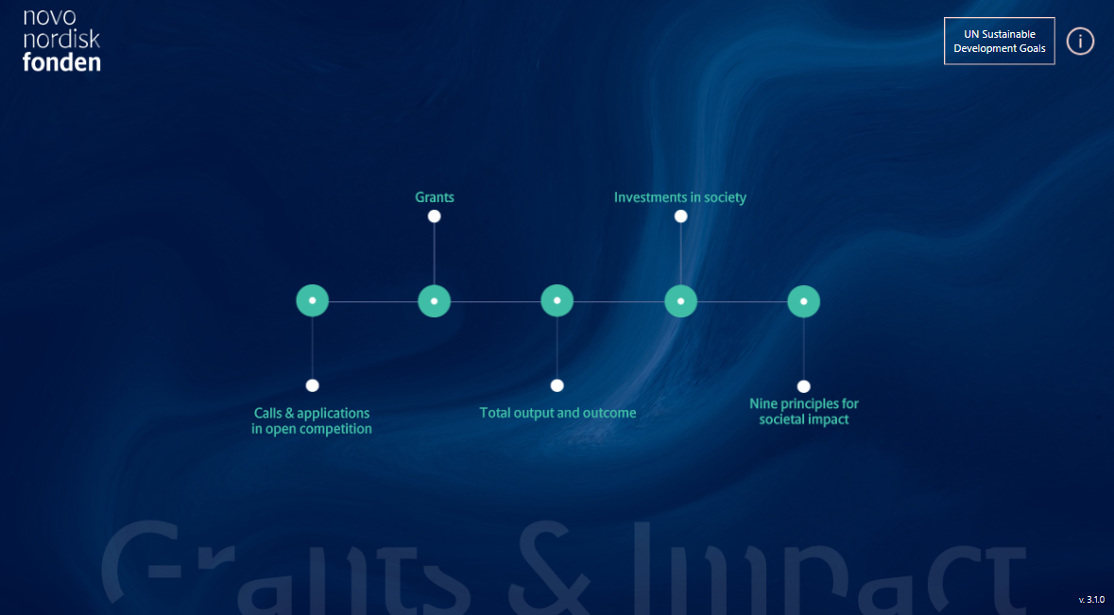
Resultater og outcomes bruges aktivt
Impact Assessment Framework: Based on the Logical Impact Model, we conduct three types of analyses
Resultater
Monitoring our progress
Evaluating our impact
Outcomes
Informing our decisions

Slide 10
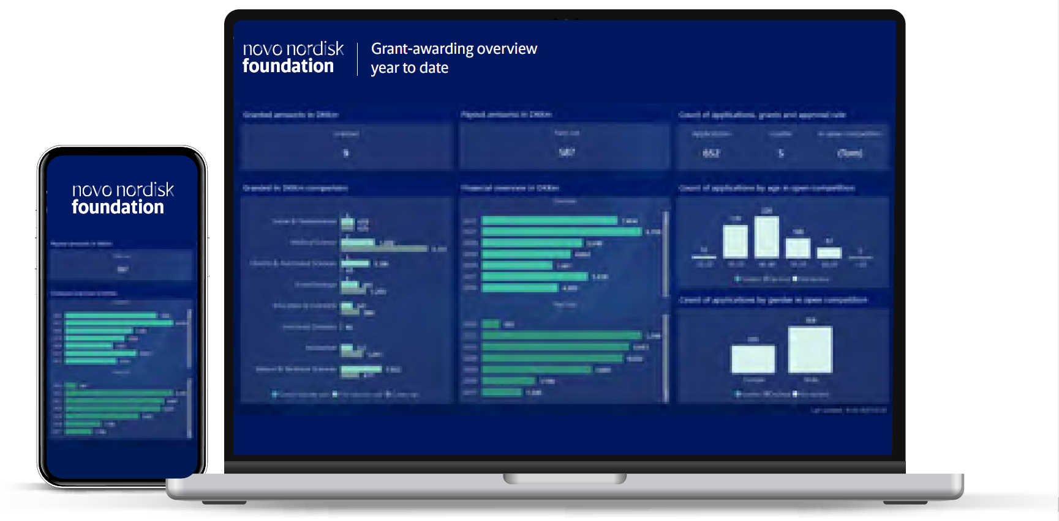
The NNF Dashboard
https://novonordiskfonden.dk/facts-and-figures/
Notes:
The story behind the Dashboard started almost three years a go when our CEO returned from a meeting with colleagues from European public and private foundations. She was during that meeting presented to a prototype of a dashboard based on application data. Upon her return she asked why can’t we have something similar just much better?
Despite or because of her whish there was an urgent need for us to clearly formulate a purpose as to why do we need an interactive dashboard? And we landed on “Developing an interactive dashboard is to support for the implementation of an evaluation and impact management culture and to be transparent towards the general public.” with this in mind we started to look at our policies and rules regarding use of data originating with our grant holders.

Slide 11
Agenda
Introduktion til Foundgood platformen
Novo Nordisk Fondens erfaringer med Foundgood
Step by Step gennemgang af rapportering til Novo Nordisk Fonden
Stil spørgsmål til din rapportering

Slide 12
Foundgood.org
NNF – Copenhagen

Slide 13
Ofte stillede spørgsmål
Jeg har kun et lille projekt skal jeg også lave en rapport?
Jeg kan ikke finder den fond jeg også får støtte fra på fondslisten – Skriv til support@foundgood.org
Jeg kan ikke finder min samarbejdspartner er ikke i oversigten – Skriv til support@foundgood.org
Hvem skal jeg henvende mig til hvis jeg har tekniske problemer? – Skriv til support@foundgood.org
Hvem skal jeg spørge hvis jeg har spørgsmål til indholdet af min rapport? – Skriv til registration@novonordiskfonden.dk
Hvor finder jeg mere information om rapportering til Novo Nordisk Fonden på https://novonordiskfonden.dk/en/impact/reporting/?tab=foundgood

Slide 14
Welcome Please turn off your microphone and video Questions can be asked in the chat
Tak for din deltagelse
Contacts:
Head of Data NNF-Impact
​Rasmus Lund Jensen
registration@novonordiskfonden.dk

