Slide 1


Welcome
Please turn off your microphone and video
Questions can be asked in the chat
welcome
Please be aware that this session will be recorded
Please turn off your microphone and video
Questions can be asked in the chat

Slide 2
Welcome
Please turn off your microphone and video
Questions can be asked in the chat
Introduction to Researchfish®
Webinar - December 2023
Head of Data, NNF-Impact
​Rasmus Lund Jensen
Junior Analyst, NNF-Impact
​Kristian Raudal

Slide 3
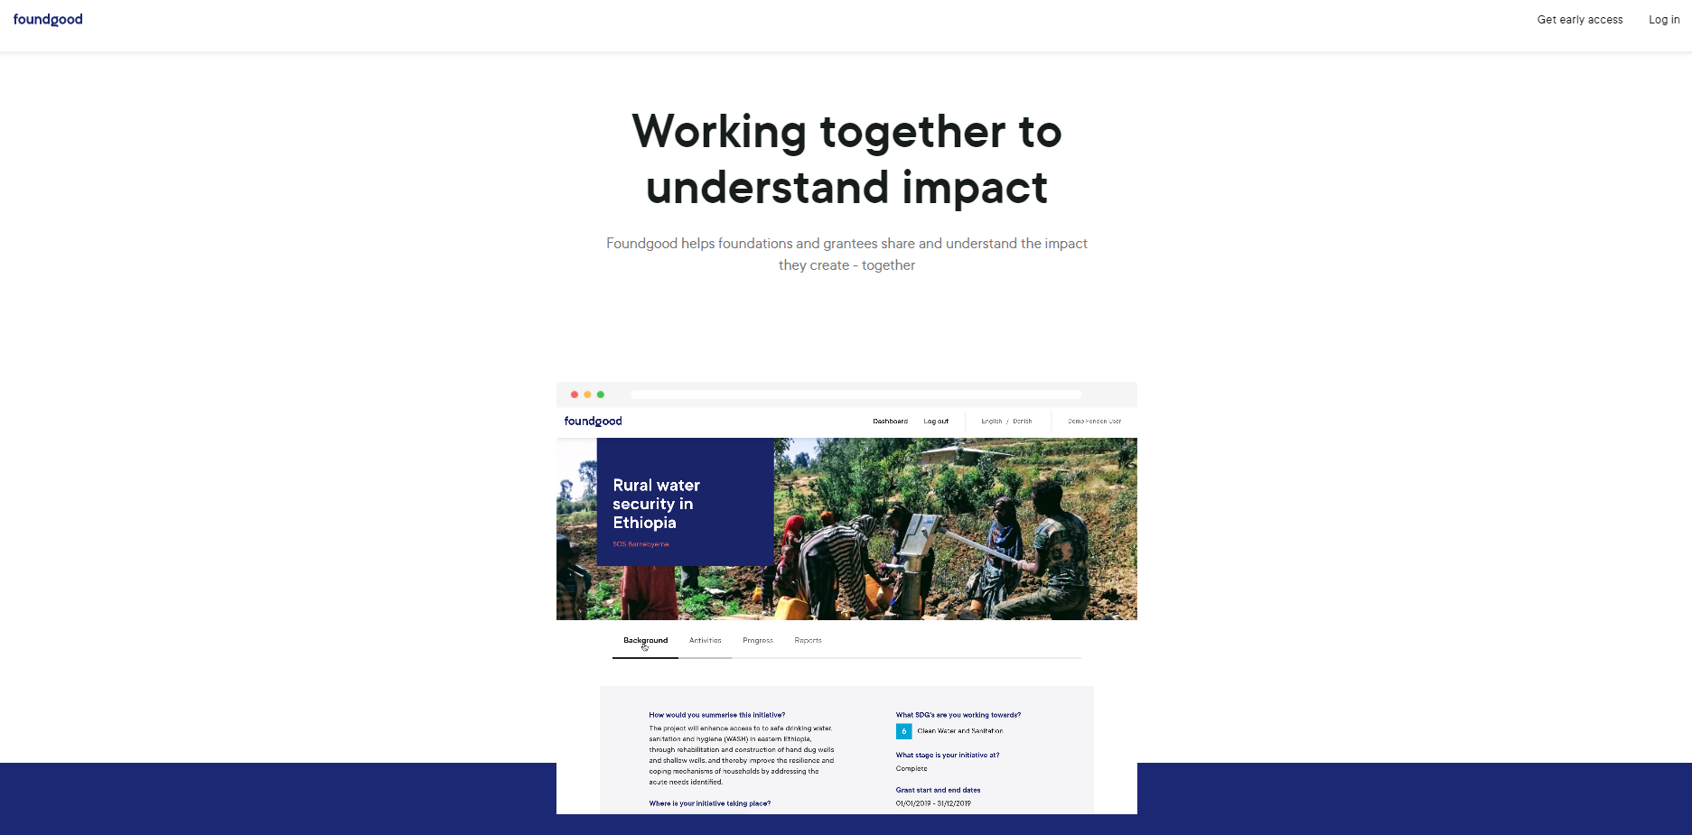
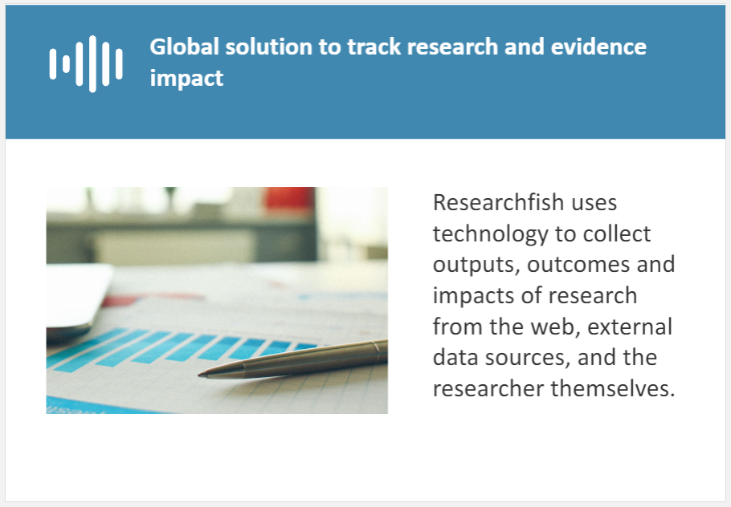
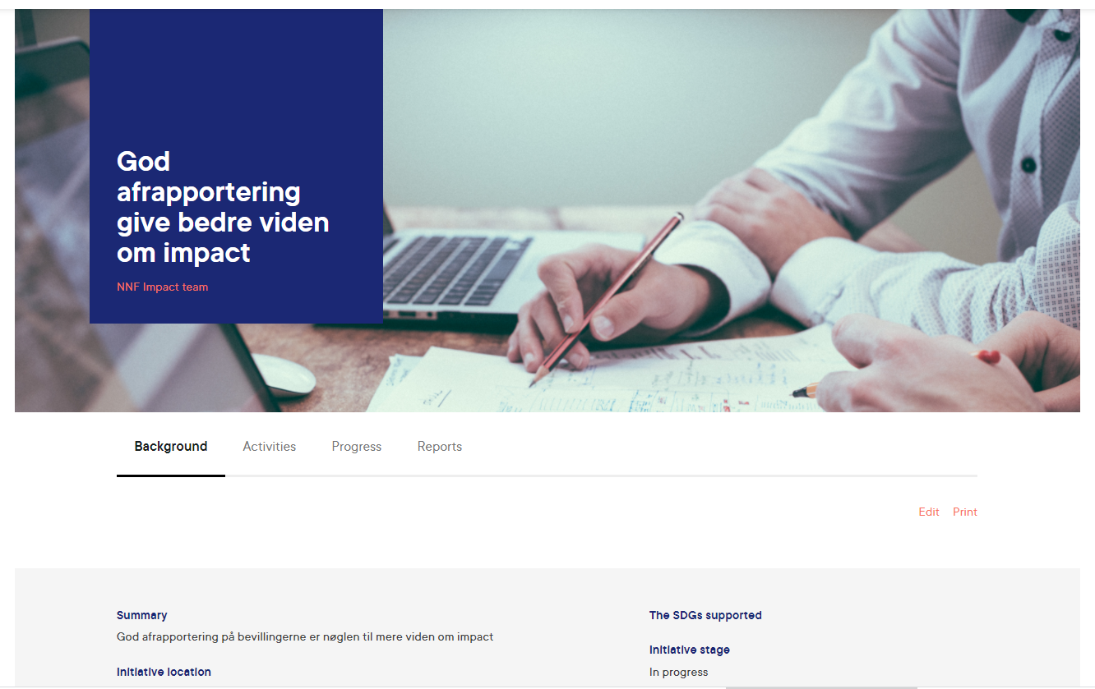
Agenda
Introduction to the reporting platform Researchfish®
Why reporting is important
What the reporting is used for
How you report

Slide 4
Researchfish®
Since 2015, the Novo Nordisk Foundation has used Researchfish® as our reporting platform for all scientific grants.
Researchfish® was introduced in 2008 by the British Medical Research Council to assist in data gathering, research tracking and measurement of grant impact.
More than 200 research funders and universities worldwide use Researchfish®.
Annually, more than 2,500 grantees who have received grants from the NNF report in Researchfish®.
Notes:
NNF has two platforms for data collection and reporting; Researchfish and Foundgood. RF is used for the research-oriented grants and FG for the social and humanitarian field as well as in the field of education, outreach and innovation.
If we compare the two platforms, RF and FG, RF has the clear advantage of having a very structured approach to collecting data, eg validation process’ is in place for publications and patent data.

Slide 5
Agenda
Introduction to the reporting platform Researchfish®
Why reporting is important
What the reporting is used for
How you report

Slide 6
Why reporting is important for Novo Nordisk Foundation
BoD
CEO office
We support an informed decision process (what works and what does not) used for advocacy towards research funding.
We communicate the overall success of NFF in a simple way to create transparency and legitimacy for our research funding.
External stakeholders
We support and facilitate evaluation and learning in the organization that supports impact management.
Program areas
We circle back input, output and outcome data to the grant holder to facilitate learning.
Grant holders
Notes:
For us there is strong ties between our overall ambitions to be transparent and to learn through data.
For us data is a tool, a tool that we need to be able to communicate and to learn. As such the data serves multiple purposes; informed decision making, communication, and learning, and for that we have developed a data strategy that supports all the four use cases. The BoD and our executive office is supported by data when they are to formulate and execute a forward looking strategy. The often look for and ask to what works and what does not. Our external stakeholders the general public is provided with a large amount of detailed data in order for us to earn the legitimacy of our considerably volume of research funding going into the Danish research community. In fact we are responsible for almost 15% of all research funding in Denmark. At the level of our program areas the data is used for evaluation and learning for the development of new or enhanced funding instruments and for impact management when the scientific officers have their annual dialog meeting with the grant holders. Finally we are feeding back the data to the actual grant holders as a way to show them what we do with all the information they provide in there annual reporting. One could also me a bit cynical and say that we by openly sharing the information that the grant holders are reporting we are hoping that they would be encouraged to be accurate and trustful with what they report.
To sum up our GOAL is to empower end users who ever they are​

Slide 7



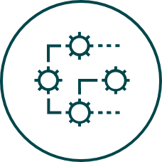





The nine societal impact principles for the Foundation
Output
Outcome
Impact
Fostering the development of talent
across different gender, life ages and
scientific fields
Supporting organisations, systems, and
infrastructure to catalyse a knowledge-
based societal development
Stimulating collaboration across
international borders, scientific
disciplines, and sectors in society
Promoting excellent
research and innovation
Developing innovative products
and solutions supporting a
sustainable development
Developing new technologies, therapies
and patient-centred and research-
based care and disease prevention
Creating jobs, sustainable growth,
efficient use of resources and
productivity in society
Support the development of world-
class education at all levels and of a
qualified and agile workforce
Supporting people in difficult
health, social, environmental,
and humanitarian settings

Slide 8
Agenda
Introduction to the reporting platform Researchfish®
Why reporting is important
What the reporting is used for
How you report

Slide 9

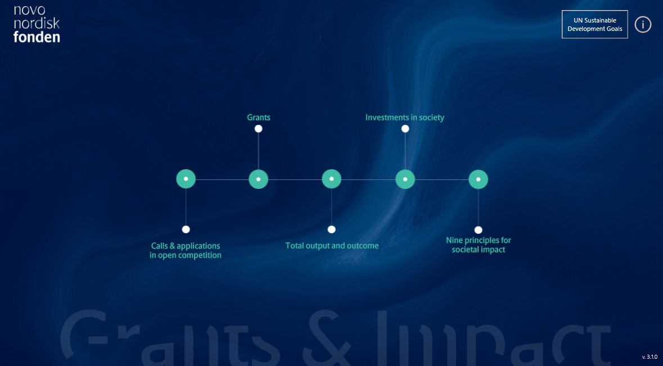
Nine principles for societal impact
Fostering
the development
of research talent
Investing
in infrastructure
Supporting
research
collaboration
Promoting
excellent
research
How we use your data in practice!
Developing
innovative products and solutions
Creating
jobs and
growth
Developing
healthcare and
new medicine
Developing
world-class
education
Empowering
vulnerable
groups in society

Slide 10
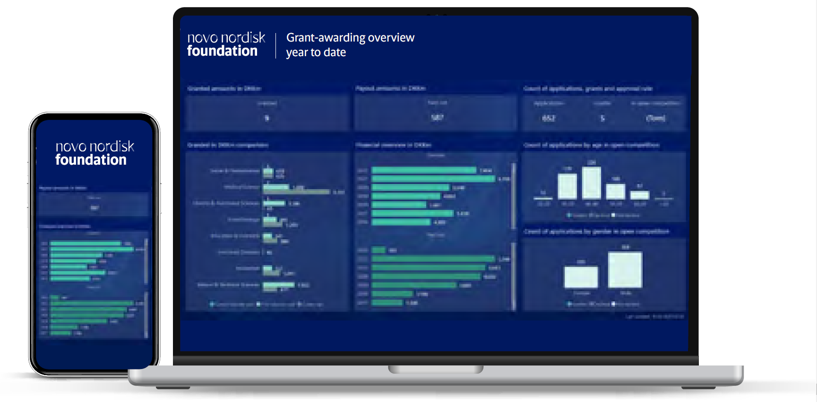
The NNF Dashboard
https://novonordiskfonden.dk/facts-and-figures/
Notes:
The story behind the Dashboard started almost three years a go when our CEO returned from a meeting with colleagues from European public and private foundations. She was during that meeting presented to a prototype of a dashboard based on application data. Upon her return she asked why can’t we have something similar just much better?
Despite or because of her whish there was an urgent need for us to clearly formulate a purpose as to why do we need an interactive dashboard? And we landed on “Developing an interactive dashboard is to support for the implementation of an evaluation and impact management culture and to be transparent towards the general public.” with this in mind we started to look at our policies and rules regarding use of data originating with our grant holders.

Slide 11
Agenda
Introduction to the reporting platform Researchfish®
Why reporting is important
What the reporting is used for
How you report

Slide 12
Reporting in Researchfish®
Researchfish helps us collect data on the outcome from:
Common Funder Questions
  Publications
  Collaborations & Partnerships
  Further Funding
  Next Destination
  Engagement Activities
  Influence on Policy, Practice, Patients & the Public
  Research Tools & Methods
  Research Databases & Models
  Intellectual Property & Licensing
  Medical Products, Interventions & Clinical Trials
  Artistic & Creative Products
  Software & Technical Products
  Spin Outs
  Awards & Recognition
  Other Outputs & Knowledge/Future Steps
  Use of Facilities & Resources
Additional Funder Questions
  Education and Professional Training
  Research-Team Information
  Supervisor and Mentor Activities
  Project Summary and Reflection
  Invention Disclosure & Ownership

Slide 13
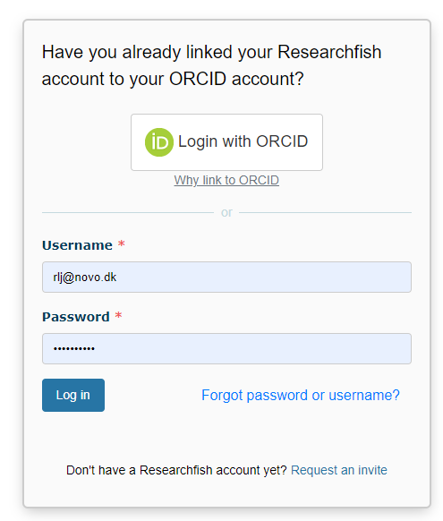
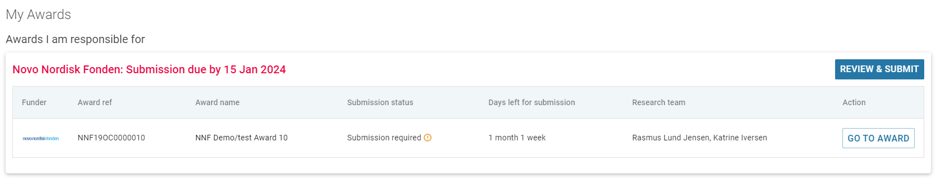
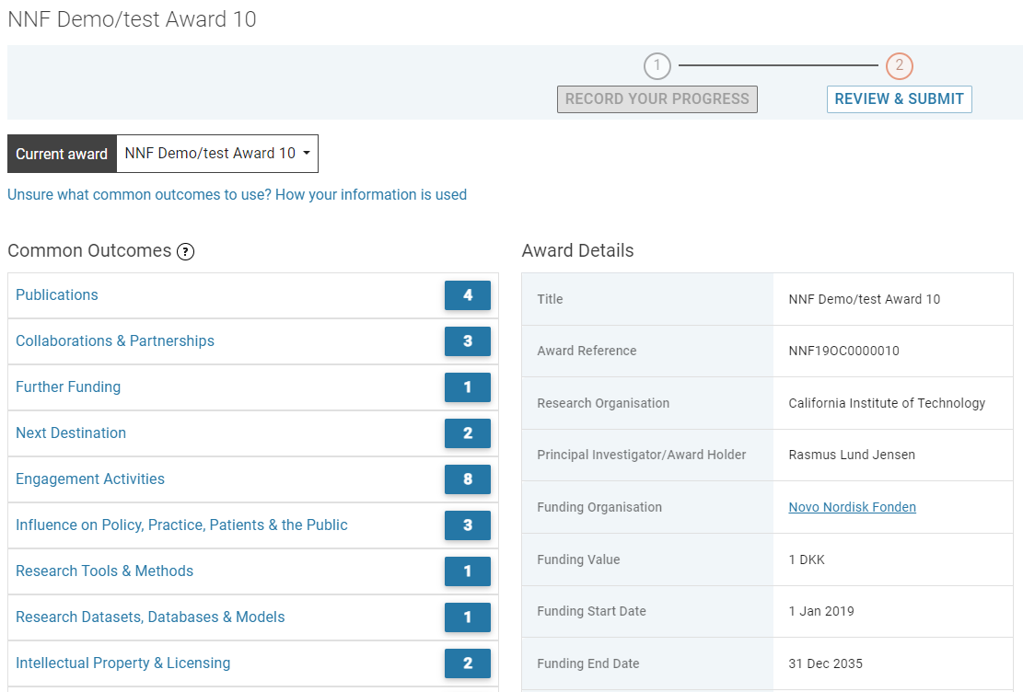
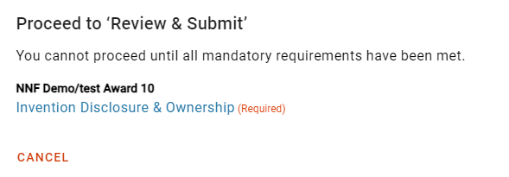
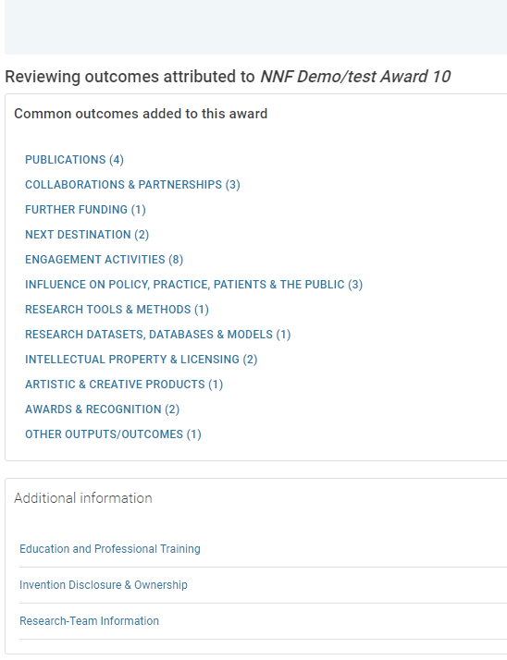

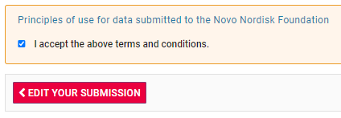
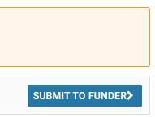
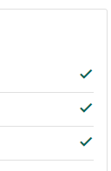
Reporting in Researchfish®
1
Login
2
Your award(s)
3
Report on outcomes
4
Review & submit
5
Review the data
6
Submit
Notes:
The role as administrative delegate, team member and PI is different

Slide 14

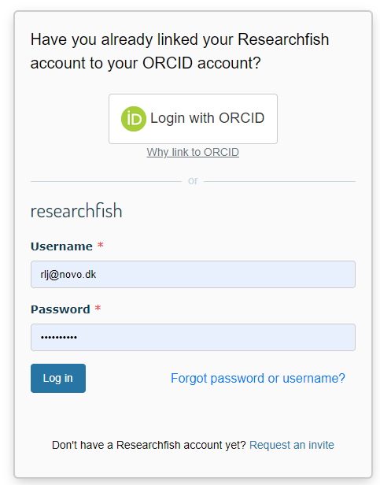
Hands on introduction to Researchfish®
- How you report
Additional Funder Questions
  Education and Professional Training
  Research-Team Information
  Supervisor and Mentor Activities
  Project Summary and Reflection
  Invention Disclosure & Ownership

Slide 15
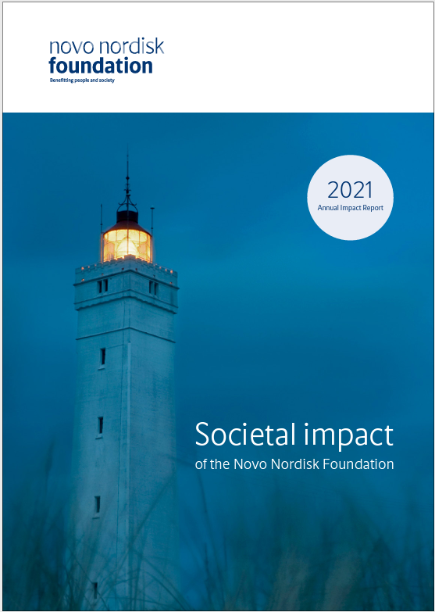
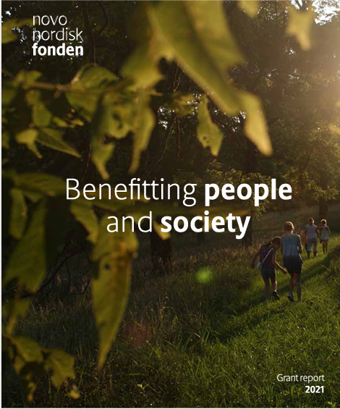



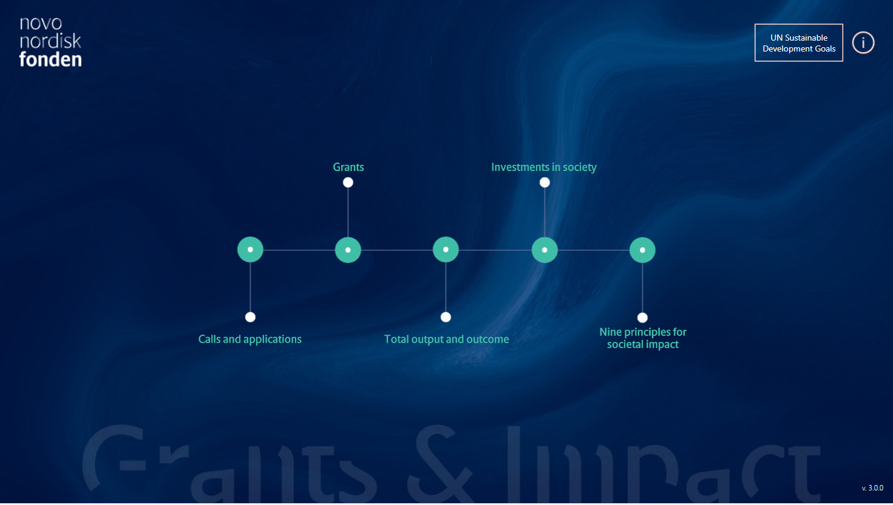


Results and outcomes are used
Impact Assessment Framework: Based on the Logical Impact Model, we conduct three types of analyses
Results
Monitoring our progress
Evaluating our impact
Outcomes
Informing our decisions

Slide 16
Reporting to the Novo Nordisk Foundation
No initiative is too small to report
All initiatives are required to report at least once a year
We will remind you of upcoming reporting deadlines
Look for help at our website https://novonordiskfonden.dk/en/impact/reporting/?tab=researchfish
Contact Researchfish® support support@researchfish.com if you have technical questions, e.g., login problem etc.
Contact NNF-Impact registration@novonordiskfonden.dk if you have questions to the content of your reporting

Slide 17
Welcome
Please turn off your microphone and video
Questions can be asked in the chat
Head of Data, NNF-Impact
​Rasmus Lund Jensen
registration@novonordiskfonden.dk
Thank you

